Slide 1
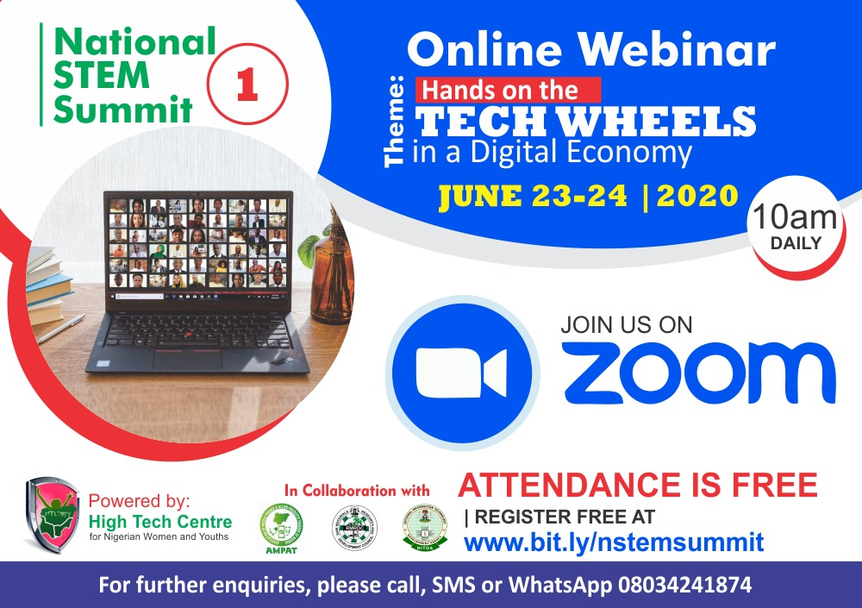
=> Presented by: Amos Emmanuel mNCS Founder, Programos Foundation
TECH-SCOUTING AND PROMOTION OF HIGH-VALUE INNOVATION
National STEM SUMMIT 2020 FINTECH & Poverty Eradication

Slide 2
TECH-SCOUTING AND PROMOTION OF HIGH-VALUE INNOVATION
National STEM SUMMIT 2020 FINTECH & Poverty Eradication
-STEM education is key to INNOVATION that is currently hacking the pandemic CRISIS

Slide 3
Innovation = Creativity + STEM + Entrepreneurship
TECH-SCOUTING AND PROMOTION OF HIGH-VALUE INNOVATION
National STEM SUMMIT 2020 FINTECH & Poverty Eradication

Slide 4
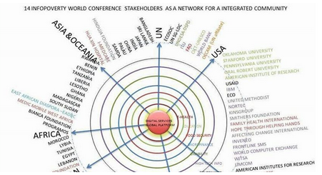
TECH-SCOUTING AND PROMOTION OF HIGH-VALUE INNOVATION
National STEM SUMMIT 2020 FINTECH & Poverty Eradication
ONLINE RESOURCES AND WEBINAR ENGAGEMENTS WILL PROFER MORE SOLUTIONS AND ACTION PLANS THAN TRADITIONAL CONFERENCE SPEECHES …
-Increased RESEARCH is hacking the pandemic- just as the search for COVID-19 vaccine is ongoing …

Slide 5
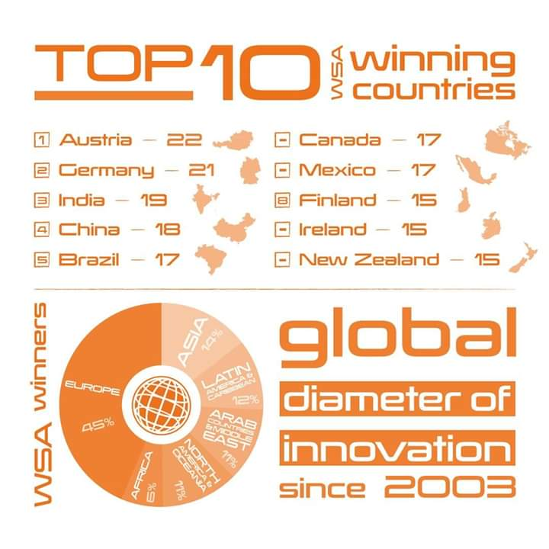
TECH-SCOUTING AND PROMOTION OF HIGH-VALUE INNOVATION
National STEM SUMMIT 2020 FINTECH & Poverty Eradication
STEM IN GLOBAL DIAMETER OF INNOVATION
-Africa needing to improve the negligible 5% share of the diameter.

Slide 6
TECH-SCOUTING AND PROMOTION OF HIGH-VALUE INNOVATION
National STEM SUMMIT 2020 FINTECH & Poverty Eradication
Are you RESPONDing?

Slide 7
How are people responding /1… ?
Resources from the WSA Community

Slide 8
How are people responding /2… ?
8
Resources from the WSA Community
FINTECH Intervention
How to engage and support communities in need in crisis times?
By Osama India
RESOURCE DATABASES TO UNDERSTAND THE PANDEMIC
https://en.medshr.net/covid
STEM AS A KEY FACTOR TO INNOVATION
Opportunity in Chaos: Startups Evolving in Difficult Times
https://www.youtube.com/watch?v=Pp2k1r2UVGY&feature=youtu.be
Proximity Solution that helps to track COVID-19
DIGITAL POLICY: THE POST PANDEMIC FABRIC FOR INNOVATION DEVELOPMENT IN AFRICA
https://www.youtube.com/watch?v=53byithmqH0&t=2436s
Corona virus assessment - AI-based medical assistant
https://www.mediktor.com/en
Innovationbed.africa FESTIVAL to be catalogued after 29th June, 2020 Programme

Slide 9
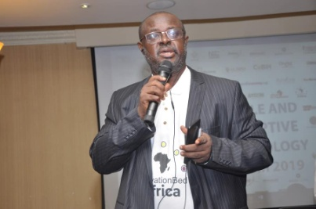
1st Entrepreneurs’ Digital Festival 2020
Amos Emmanuel mNCS, FIIM
President, Programos Foundation
2
4
The BEAMING TOUCH
With the Special Guests
Celebration/Parting Shots
By Panelists/Special Guests
1
3
Who is HELPing?
- The Power and Place of the African Innovator
Convener’s Introduction
10-Country Panel
Ralph Simon (Chairman)
-Kamran Elehian (Special Guest)
-Dominic Odunuga (Special Guest)
-Daniela Plewe (PhD) (Special Guest)
Presentations

Slide 10
How are people responding /3… ?
Resources from the WSA Community

Slide 11
Recent Actions that we have influenced in a pandemic …

Slide 12
How do we earn our credibility … ?
This is both an International and local problem
More remote work opportunities expanding
Craze for funding and generally a lot money – an innovator need be careful! The UNICORN, ZEBRA propagation were never there when Facebook and many early ventures had their break-throughs
- Imbibe ISO for management of your practice to avoid failure costs
-Self-Satisfaction is very important
- Customer satisfaction is key
- user loyalty to product is very important
- mutually aligned and favorable service agreements will take you far
- Customers with age of experience is a good reference – it worked for me!

Slide 13
Prosperity from Innovation … ?
Self experience sharing …
Prosperity today enjoys digital blessings – in that scope
and size in multiple rather than
the old scope of single and running around the streets
Expand your horizons
Where is the Government In all of this? GOVERNMENTS in Africa
who have the largest part of OUR demands will need a full day webinar to listen to innovators’ and things may not cause the desired change overnight!!!

Slide 14
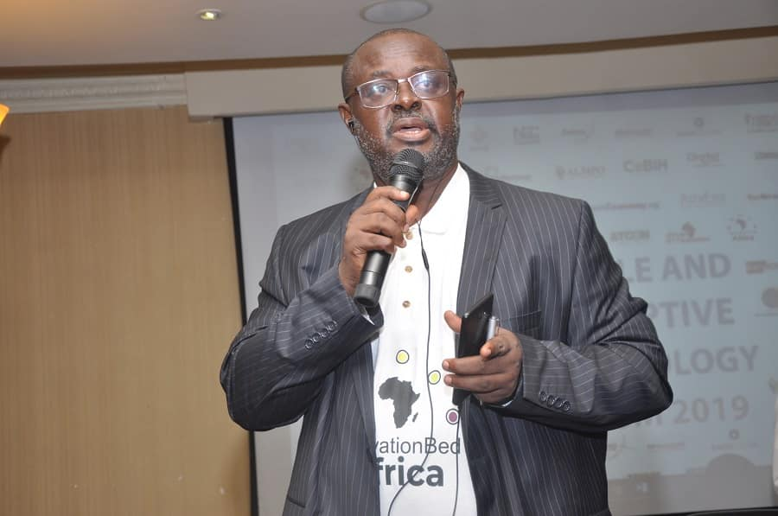
-THANK YOU-
14
If you are Nigerian and have an innovation
of high impact for WSA global rating:
NIGERIA: Register your product today:
https://db.icnm.net/Signup/WSA/2020/Nigeria/
To join our AFRICA ENTERPRENEURSHIP FESTIVAL/Compendium
https://mailchi.mp/2132a7c536c3/1st-innovationbedafrica-entrepreneurs-digital-festival-2020?fbclid=IwAR3kdCBzod8QDSU2gDXCoNChkn3PkrND78qx7dyiMjVwe8Zu7NwuU7zN-bg
Emmanuel Amos
Director Africa,
Global Digital Foundation
Founder, Programos Foundation and Architect (Innovationbed.Africa)
Architect/CEO Programos Software Limited
Member UN ICT4SIDS Strategic e-Planning Working Group
WSA GRAND JURY MEMBER
(Nigeria)
nigeria@innovationbed.africa
Programos.amos@gmail.com

